Slide 1

Chapter 3: Pattern Discovery in Data Mining
Notes:
1

Slide 2
Advanced Topics on Pattern Discovery
Objective
Brief overview of advanced topics in pattern discovery
Subgroup discovery, contrast pattern mining, emerging pattern mining, etc.
Cutting-edge research and emerging trends in pattern discovery
2

Slide 3
Advanced Topics on Pattern Discovery
Challenges for Data Analysis in Data Streams
Data Streams
Features: Continuous, ordered, changing, fast, huge volumn
Contrast with traditional DBMS (finite, persistent data sets)
Characteristics
Huge volumes of continuous data, possibly infinite
Fast changing and requires fast, real-time response
Data stream captures nicely our data processing needs of today
Random access is expensive: single scan algorithm (can only have one look)
Store only the summary of the data seen thus far
Most stream data are at low-level and multi-dimensional in nature, needs multi-level and multi-dimensional processing
3

Slide 4
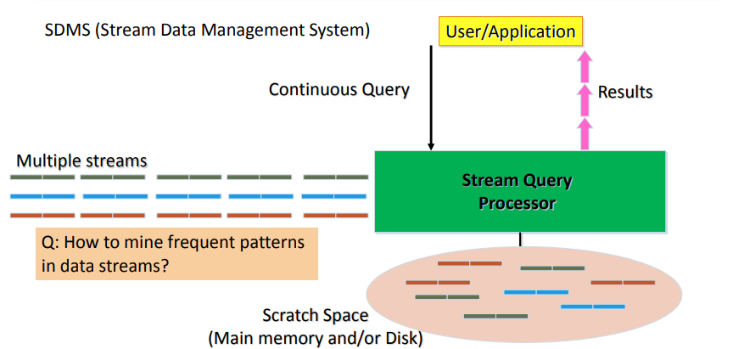
Advanced Topics on Pattern Discovery
Architecture: Stream Data Processing
4

Slide 5
Advanced Topics on Pattern Discovery
Stream Data Mining Tasks
Stream mining vs. stream querying
Stream mining shares many difficulties with stream querying
E.g., single-scan, fast response, dynamic, …
But often requires less “precision”, e.g., no join, grouping, sorting
Patterns are hidden and more general than querying
Stream data mining tasks
Pattern mining in data streams
Multi-dimensional on-line analysis of streams
Clustering data streams
Classification of stream data
Mining outliers and anomalies in stream data
5

Slide 6
Advanced Topics on Pattern Discovery
Mining Approximate Frequent Patterns
Mining precise frequent patterns in stream data: Unrealistic
Cannot even store them in a compressed form (e.g., FPtree)
Approximate answers are often sufficient for pattern analysis
Ex.: A router
is interested in all flows whose frequency is at least 1% (σ) of the entire traffic stream seen so far
and feels that 1/10 of σ (ε = 0.1%) error is comfortable
How to mine frequent patterns with good approximation?
Lossy Counting Algorithm (Manku & Motwani, VLDB’02)
Major ideas: Not to keep the items with very low support count
Advantage: Guaranteed error bound
Disadvantage: Keeping a large set of traces
6
Notes:
làm sao để tìm ra các mẫu nổi tiếng - Case study: Nhà mạng Viettel (100 users)
-> Tìm các lỗi nta hay gặp phải, cho nhân viên tìm kiếm lỗi, -> Tập trung vào những nhóm 1% 1 tr người dùng, sử dụng mạng nhiều nhất. -> 1% người này có thể 99% người kia có thể dính lỗi (bao quát)
- Thuật toán Lossy Couting: (Đừng giữ những thành vấn với tổng số support thấp )

Slide 7
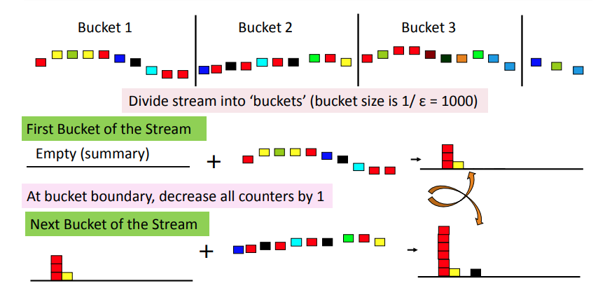
Advanced Topics on Pattern Discovery
Lossy Counting for Frequent Single Items
7
Notes:
1/0,001 = 1000
epsilon = 0,001
- Phần tử đầu tiên luôn trống
trừ đi tất cả phần tử trừ đi cho 1 đơn vị -> để giảm số lần đến, giảm số lần lưu trữ vô cùng nhỏ -> tiết kiệm phần lớn không gian lưu trữ.
- không xóa dữ liệu bữa bãi

Slide 8
Advanced Topics on Pattern Discovery
Approximation Guarantee
Given: (1) support threshold: σ, (2) error threshold: ε, and (3) stream length N
Output: items with frequency counts exceeding (σ – ε) N
How much do we undercount?
If stream length seen so far = N and bucket-size = 1/ε then frequency count error ≤ # of buckets = N/bucket-size = N/(1/ε) = εN
Approximation guarantee
No false negatives
False positives have true frequency count at least (σ–ε)N
Frequency count underestimated by at most εN
8
Notes:
Hệ thống cho chúng ta đếm thiếu undercount trừ đi tối đa bao nhiêu lần. -> công thức (epsilon x N)
0,001 x 10000 = 10

Slide 9
Advanced Topics on Pattern Discovery
Other Issues and Recommended Readings
Other issues on pattern discovery in data streams
Space-saving computation of frequent and top-k elements (Metwally, Agrawal, and El Abbadi, ICDT'05)
Mining approximate frequent k-itemsets in data streams
Mining sequential patterns in data streams
Recommended Readings
G. Manku and R. Motwani, “Approximate Frequency Counts over Data Streams”, VLDB’02
A. Metwally, D. Agrawal, and A. El Abbadi, “Efficient Computation of Frequent and Top-k Elements in Data Streams”, ICDT'05
9

Slide 10
Advanced Topics on Pattern Discovery
Pattern Discovery for Software Bug Mining
Software is complex, and its runtime data is larger and more complex!
Finding bugs is challenging: Often no clear specifications or properties; need substantial human efforts in analyzing data
Software reliability analysis
Static bug detection: Check the code
Dynamic bug detection or testing: Run the code
Debugging: Given symptoms or failures, pinpoint the bug locations in the code
Why pattern mining?—Code or running sequences contain hidden patterns
Common patterns → likely specification or property
Violations (anomalies comparing to patterns) → likely bugs
Mining patterns to narrow down the scope of inspection
10
Notes:
Chiến thuật trong datamining để sửa lỗi code. - Bất kì đoạn code nào vi phạm

Slide 11
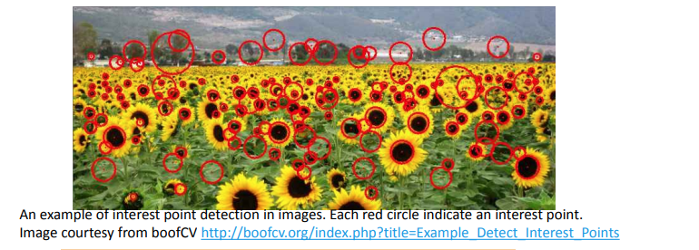
Advanced Topics on Pattern Discovery
Image Representation for Visual Pattern Discovery
An image can be characterized by visual primitives, e.g., interest points
Each visual primitive can be described by visual feature, e.g., a highdimensional feature vector
Each image is a collection of visual primitives
11

Slide 12
Advanced Topics on Pattern Discovery
Pattern Mining and Society: Privacy Issues
A potential adverse side-effect of data mining—Privacy could be compromised
Privacy and accuracy are typically contradictory in nature
Improving one often incurs a cost on the other
Three categories on privacy issues arising out of data mining
Input privacy (or data hiding)
Distort or hide data to prevent the miners from reliably extracting confidential or private information
Output privacy (or knowledge hiding)
No disclosure of sensitive patterns or knowledge from datasets
Owner privacy
Does not allow any party to reliably learn the data or sensitive information that the other owners hold (i.e., the source of the data)
12

Slide 13
Summary
Advance Pattern Discovery
Cutting-edge areas: Subgroup, contrast, emerging patterns.
Addressing complex data challenges.
Embracing evolving trends in research.
13

